Slide 1




Artificial Intelligence, it’s excessive use and ethics.
A presentation by Group I (Fardan, Arhum, Siddique and Muhammad Abeer)

Slide 2
The core idea behind AI and it’s limitations
Artificial Intelligence (or any other technology in this case) was made to aid humans by making tasks easier. It should be noted that there’s a massive difference between using a tool to help solve your problem quickly and completely relying on that tool.
AI is still in it’s development stage and not all information provided by an AI will necessarily be accurate. There’s uncertainty still present and unlike your typical calculator which only performs mathematical operations and is reliable, AI has a broader use case and therefore gives unreliable output on some occasions. It is meant for general use, not complicated tasks like solving your entire homework or doing creative work (we’ll go over this topic later in the presentation).

Slide 3
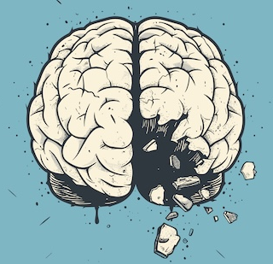
Excessive use of AI and it’s consequences
“To every action there’s an equal but opposite reaction” - Sir Isaac Newton

Slide 4
Excessive use by students
When a student goes to any educational institute, his/her goal should be to learn new things but the truth is, the majority of students nowadays only go to such institutions for the sake of ‘getting a degree’ or because of ‘parental pressure’. Such a contrast in mindset leads to corruption in the educational system and these students tend to look for ‘shortcuts’ ie. cheating their way to the degree they’re simply not eligible for. AI has indeed become such a shortcut and students excessively use it to do their entire homework ending up learning absolutely nothing and even losing their skills and knowledge they had once acquired as they stopped using them. It can be argued that homework itself is a stupid concept but that’s an argument for some other day. The point is, we should use AI for assistance whenever we get stuck, it can act as a private tutor and our learning process can get better through this route instead of completely relying on it.

Slide 5
Excessive use by developers
The people who are making the most use of AI are actually the software developers themselves (who could’ve guessed) and not particularly the veterans of this field but rather the newcomers, as we talked earlier, people tend to look for shortcuts when their goals are in contrast with the actual purpose of the field. C.S fields suffer from the same problem and while AI can greatly help you understand the basics and debug your code, it should not be completely relied upon by copy-pasting all your code from these LLMs. This way, neither your problem solving skills will develop nor will you ever learn how your programs actually work. Once a bug large enough for your AI to get stuck occurs in your code, you’ll be stuck forever. Such developers are famously known as “Vibe Coders” in the programming space.

Slide 6
Excessive use by Elites of The Corporate World
The Elites of The Corporate World like CEOs of tech giants like Google, Microsoft, Nvidia, Meta etc. have become obsessed with AI not just because it’s a new technology they can make a business out of but more so because they wish to fire as many employees as possible and replace them with AI even though it is still not better than most human programmers and has ruined many online services (a famous example being Duolingo, the language learning app) and it’s quite clear why they’re doing this, in case you still haven’t figured out the reason, they’re doing this to cut their costs and save money so it can go into their pockets instead of the employees even at the cost of a much worse product than the original one. To jump on the AI hype-train, many companies are also implementing it in unnecessary places and products where it’s presence makes no sense whatsoever.

Slide 7

Environmental Pollution from data centers running AI models
Hosting these powerful AI models is extremely expensive and requires large amounts of electrical energy as well as water supply for cooling. These data centers are one of the largest sources of greenhouse gas production and water pollution. They also cause a lot of noise pollution, which disturbs the people living near them and their surroundings.

Slide 8
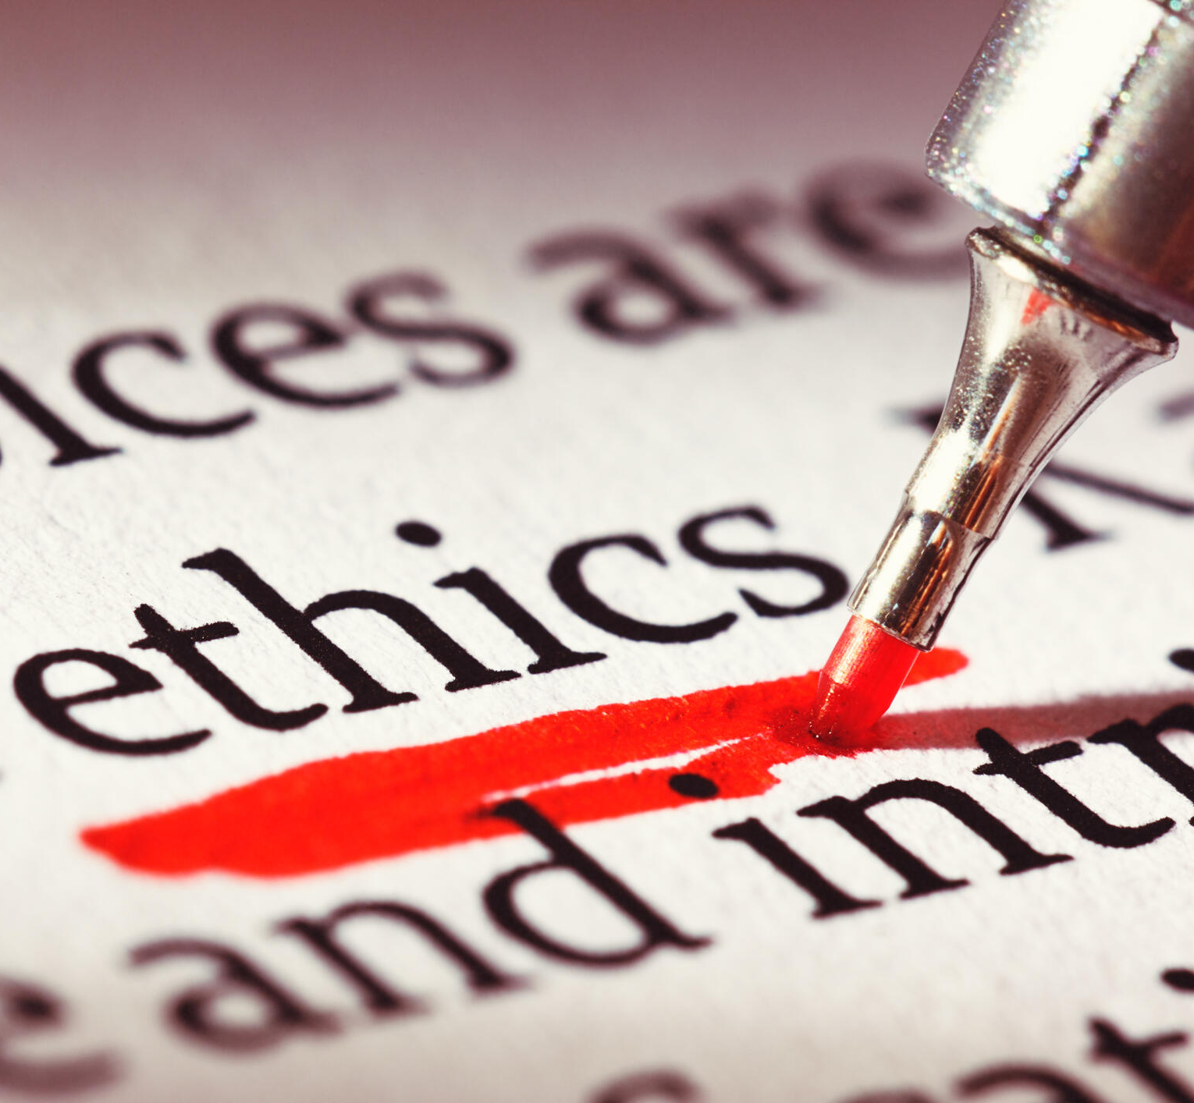
The Ethics of using AI
It’s always better to follow the rules, both for you and the people around you.

Slide 9

Be Creative
Us Humans have a very special brain, unlike a computer, it does not just store memories but also has emotions, feelings, biases and that’s what make us special, that’s what makes us creative. A good artist with great inspirations will always manage to produce better work than someone who is less experienced, whether it’s through AI or by hand. These emotions that an artist carries are what make any piece of art so special.

Slide 10
Human Connections and Original Ideas
Human beings always require some sort of connection to stay mentally stable. Talking to AI ‘friends’ puts you in an ecological chamber where your own ideologies are constantly being reflected over and over again and you are never able to understand the ideologies and perspectives of other people. We should maintain healthy relations with everyone and try to understand other people’s perspective, thinking “I’m right and everyone else is wrong” is an incredibly unhealthy way of thinking and becomes an obstruction in the path toward becoming a humble and empathic man. Locking yourself in eco-chambers will result in a confined mind where no original ideas will come and even with that short term pleasure you’ll become depressed at the end.

Slide 11
AI as a tool and importance of hard work
Passing all your work to AI will make you end up with nothing to do and life will start feeling meaningless because we as humans are designed for hard work. I once read in a post on reddit about productivity from a 50 year old man that “Happiness doesn’t come from doing little work and getting lots of rest, you feel happy when you rest after doing hard work”. Using AI to make your work a little easier or asking it for help whenever you’re stuck is totally fine, that’s actually a great use of AI and from my perspective, that’s what AI should be used for. Remember, AI is a tool, not a replacement. Replace your job with AI and some day your boss will replace you with AI as well. Mindless use of AI will also blind you from the procedure towards getting to your result and if AI tools aren’t available, well you’ll just stay stuck in that problem.

Slide 12
The End
Thanks for listening!

